Slide 1

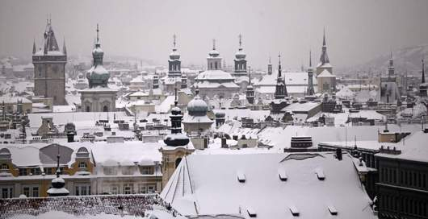



Nominated for European Business Award
Received price of Ministry of the Environment of the Czech Republic within the prestigious nomination “Czech Head”
Owner of several strategic technologies
Scored second in prestigious Czech prime minister’s award ”Innovation of 2010”
Participate in several FP7 consortiums
FN®
2. Generation of photocatalytic products
Nano-TiO₂ Efficiency in FN Coatings
            Jan Prochazka
            jan.prochazka@advancedmaterials1.com
www.advancedmaterials1.com

Slide 2
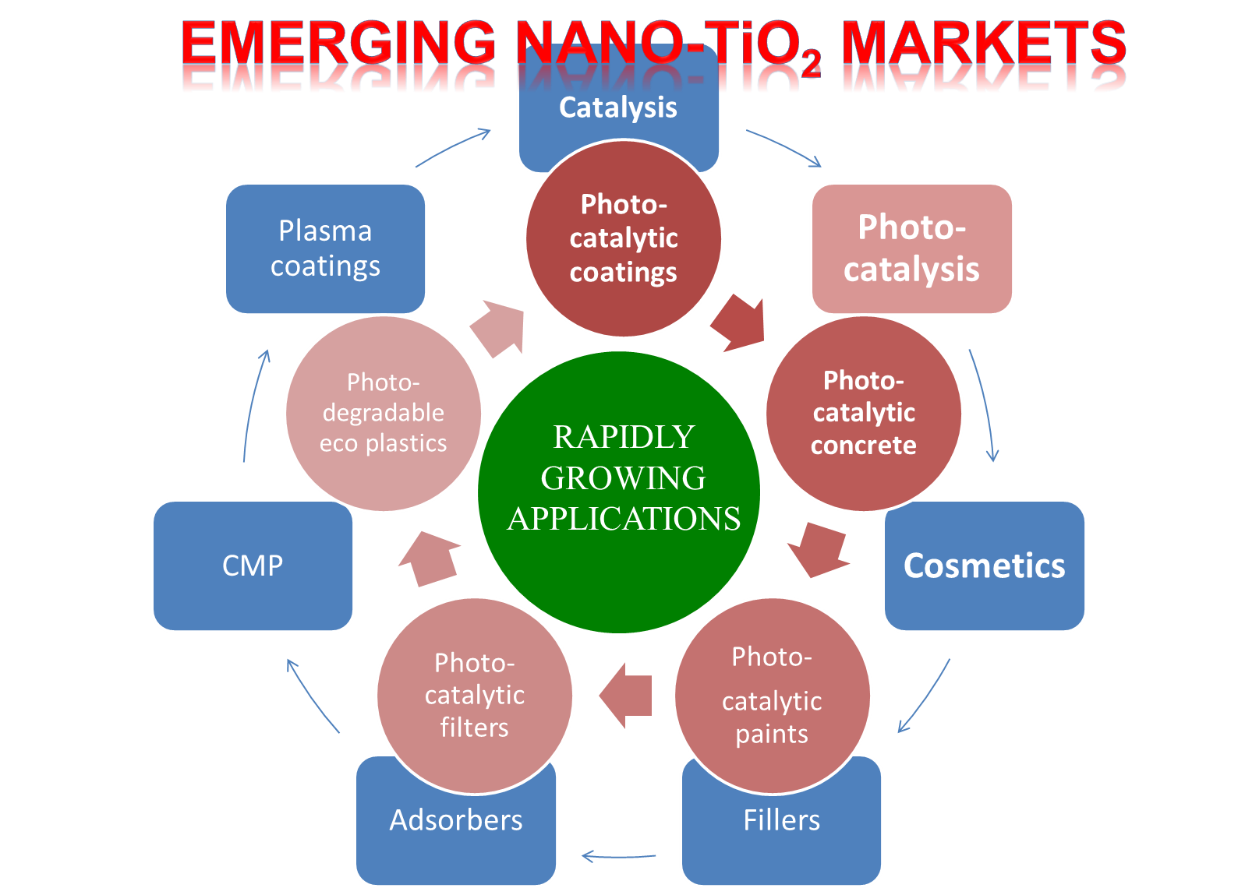
(EXPECTED GROWTH OVER 20%/Y)
Market for TiO₂ Nanoparticles

Slide 3
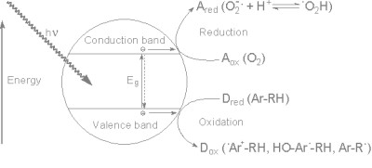
How does it work?
CONVERSION OF LIGHT ENERGY INTO AN OXIDATION POTENTIAL ON THE SURFACE OF TITANIUM DIOXIDE
+
ORGANICS
(SMOKE, MICROBES, VAPOUR, ETC)
AIR OXYGEN
+
LIGHT
H₂O + CO₂
+
TiO₂ SURFACE
Eg ~ 3.2eV

Slide 4
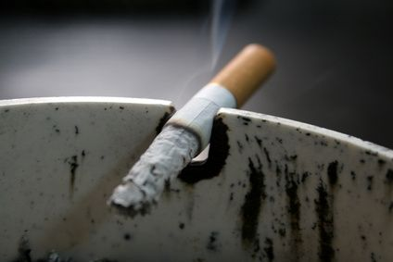
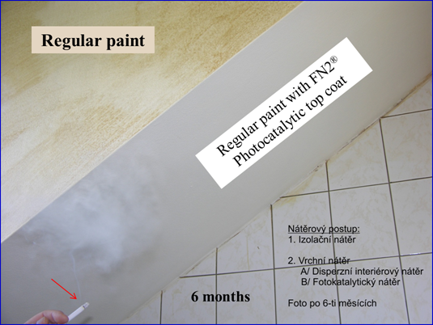
SMOKING
ROOMS
FAST SMOKE REMOVAL
ODOR ELIMINATION
NO MUSTY DEPOSITS
FN® COATING:
EXAMPLE: SMOKE IN THE AIR
When smoke comes into contact with the photocatalytic surface, it reacts (burns) with oxygen in the air creating molecules of water, CO₂ and other mineral compounds. Same thing happens to an endless list of other organic molecules.
6 MONTHS

Slide 5


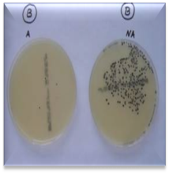


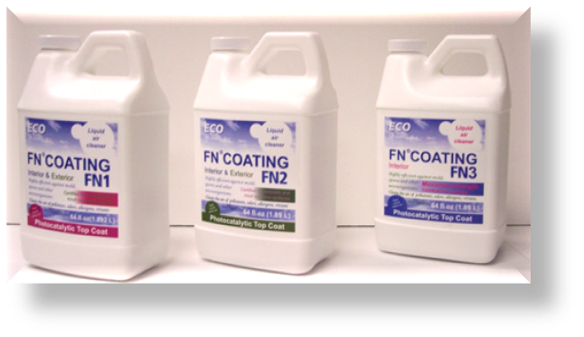
FN® PHOTOCATALYTIC
COATINGS
INDOOR USE
SICK BUILDING SYNDROME SOLUTION
Remove bad odors
Burn smoke
Eliminate allergens
Prevent musty deposits
Stop mold
Kill viruses and bacteria
Protect health
Lower risk of infection
BREATHE SAFE AIR

Slide 6






FN® COATINGS IN MEDICAL AND PUBLIC BUILDINGS
PUBLIC HEALTH PROTECTION
VERY EFFICIENT NON-CHEMICAL SANITARY FUNCTION
SCHOOLS
KINDERGARTENS
HOSPITALS
MEDICAL CENTERS
BIOLABS
OFFICES
BANKS
PUBLIC BUILDINGS
TRAIN/BUS STATIONS
AIRPORTS

Slide 7
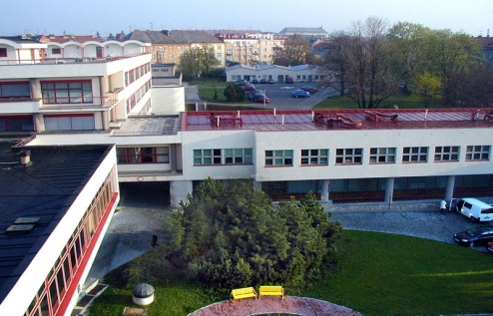

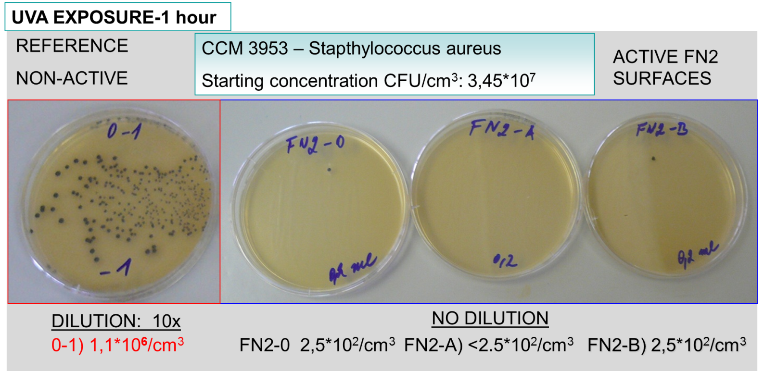
MRSA is a serious hospital acquired infection, which is a form of the Staphylococcus bacterium resistant to the commonly used antibiotic methicillin.
PROVIDES HELPFUL PROTECTION TO CHILDREN AND OTHER PATIENTS ON CHEMOTHERAPY
PREVENTION OF INFFECTION OUTBREAK

Slide 8
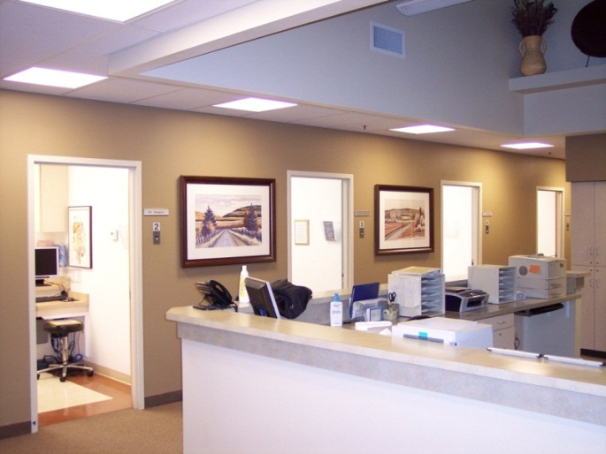


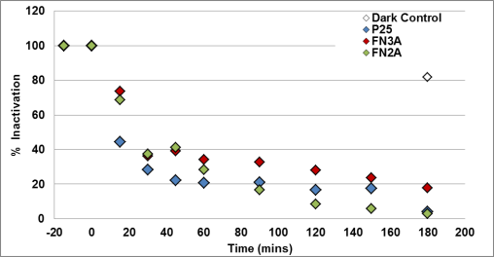
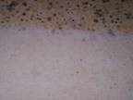

FN® TREATED MEDICAL CENTER IN RENO, USA
KILLS
&
CLEANS
Kills viruses, bacteria and other microorganisms
Decomposes (burns) toxins and dead microorganism bodies
+

Slide 9
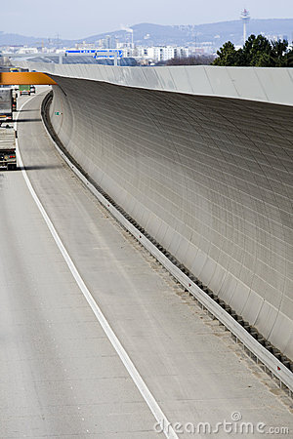

FN® COATINGS:
OUTDOOR USE
SURFACE PROTECTION
FUNDAMENTAL PROPERTIES MAXIMIZED
PRACTICAL USE
ENVIRONMENTAL BENEFITS
ECONOMICAL BENEFITS
APPLIES LIKE A PAINT
WORKS LIKE AN AIR PURIFIER
EFFICIENT SURFACE PROTECTION WITH A SELF-CLEANING EFFECT

Slide 10
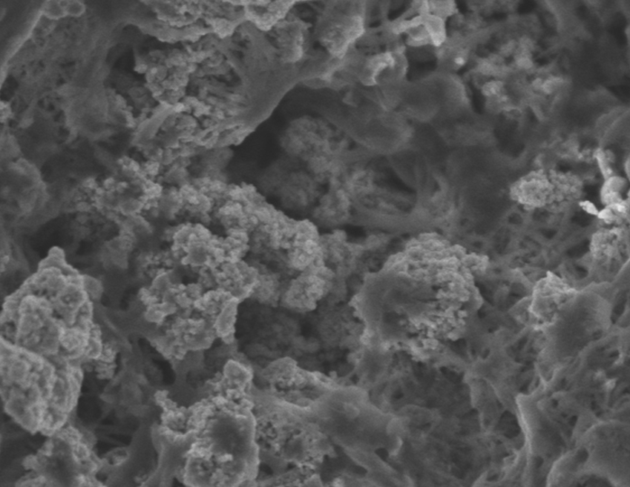
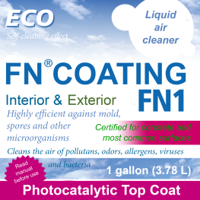
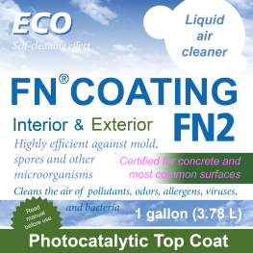
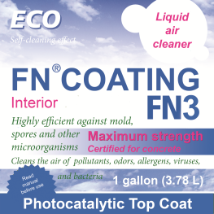
PREVENT SURFACE AGEING
EROSION PROTECTION
PREVENTION OF MICROORGANISMS
SELF-CLEANING EFFECT
PURIFICATION OF AIR
ANTIGRAFFITI EFFECT
UV PROTECTION
SAVE MONEY FOR SURFACE CLEANING

Slide 11
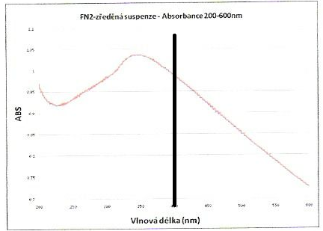
FN® COATINGS=
UV SHIELD
UV PROTECTION
FN® COATINGS ABSORB UV, THUS PROTECTING THE COATED SURFACE FROM UV RADIATION
PROVIDE UV SHIELD TOTHE ACRYLIC PAINT COAT OR OTHER BASE MATERIAL UNDERNEATH
SLOWS:
AGEING
BLEACHING
FADING
WEARING DOWN
UV
VIS
10 MICRONS FN® LAYER ABSORBS OVER 99.9 % OF THE SUN UV RADIATION

Slide 12
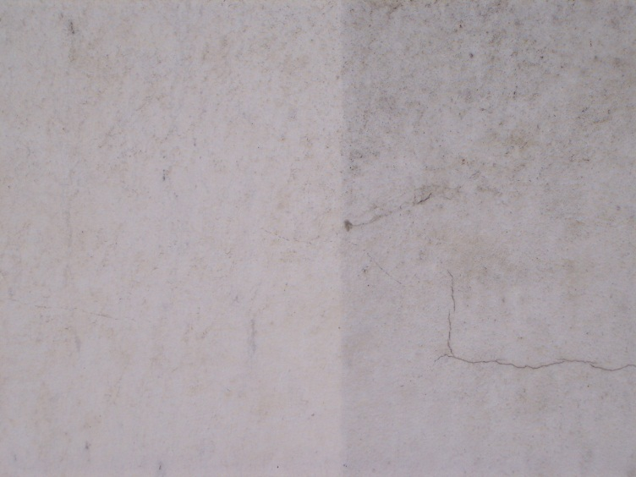
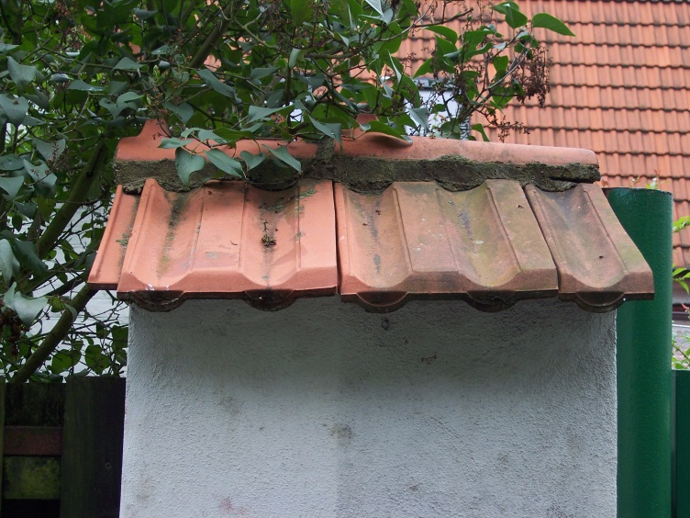
ABSORBED UV RADIATION ACTIVATES FN® COATINGS CREATING:
HIGHLY OXIDATIVE SURFACE, CAPABLE OF ELIMINATING POLUTANTS FROM THE AIR AND DESTROYING ERODING MICROORGANISMS.

Slide 13
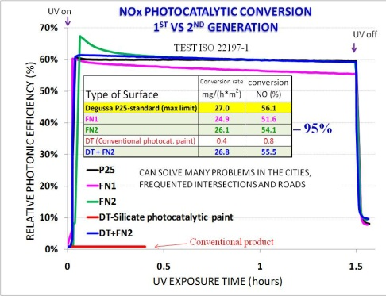
FN® PHOTOCATALYTIC COATINGS
ISO 22197-1 test NOx Conversion
FN® are nearly hundred times more effective than conventional products of the first generation (based on silicate, silicon or acrylate binders or sol-gel).
ISO TEST CONDITIONS:
GAS FLOW ~ 0.2 m/s (simulation of light wind)
Concentration of emissions – 1 ppm
(analogy to heavy traffic jam)
UV INTENSITY– 1 SUN (simulation of a sunny day)
ISO 22197-1 Test analysis:
1 m² of FN® treated surface will decontaminate over 3,000,000 m³ of air annually!!!

Slide 14
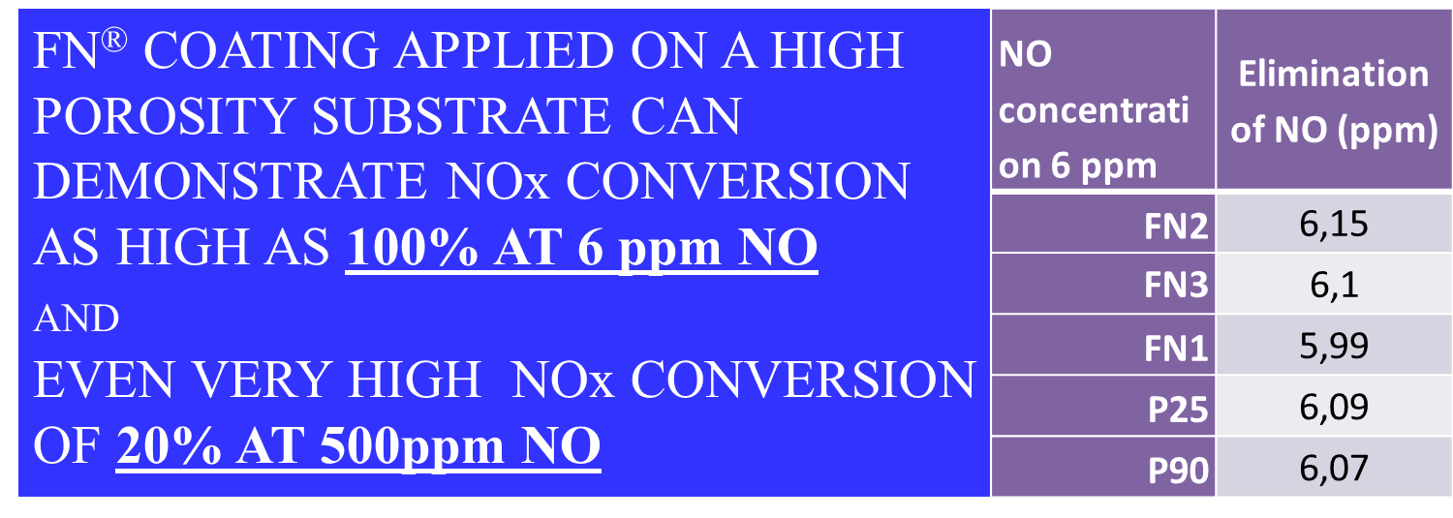


UV on
NOx PHOTOCATALYTIC CONVERSION
FN® PHOTOCATALYTIC COATINGS
CAN HANDLE THE NOx CONVERSION ISSUE!!!
ISO 22197-1
UV off

Slide 15
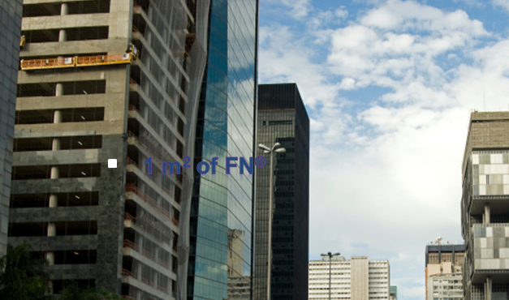
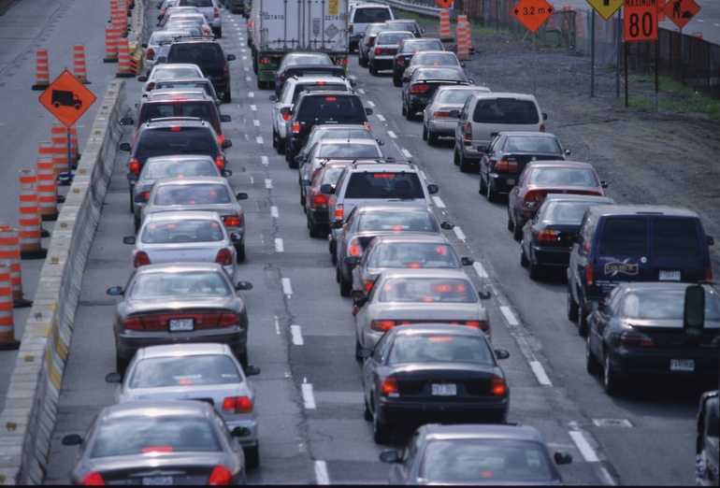

PRACTICAL EXAMPLE BASED ON THE ISO 22197-1 test :
WHAT 1 m² OF FN® CAN DO FOR THE CITY HEALTH
CONSIDERING:
DAYLIGHT – 10 hours/day
WIND ~ 0.2 m/ s
  (1 Year ~ collision of 6,307,200 m³ of air with 1m² FN®)
NOx Conversion rate ~ 50%
ONE PASS COLLISION WITH FN®
1 m² of FN®
1m² FN®
(~5 grams of TiO₂)
cleans 1,314,000 m³ of air of 50% pollutants annually
removing over 0.1kg of harmful compounds
Daylight 10 hours/ day
Dark 14 h/ day

Slide 16
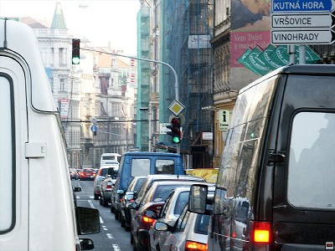
Large building with 10,000m² treated by FN® can clean the air from one ton of pollutants annually.
In addition FN® protects the façade from darkening.

Slide 17
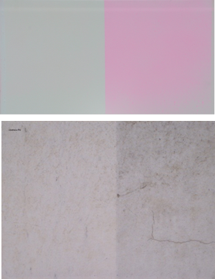
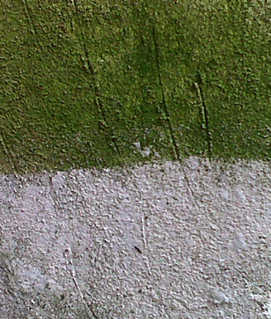
SURFACE PROTECTION
1m² FN®
(~5 grams of TiO₂)
cleans 1,314,000 m³ of air of 50% pollutants annually
removing over 0.1kg of harmful compounds
DECONTAMINATES AIR AND KEEPS THE SURFACE CLEAN AT THE SAME TIME
PROTECTED FROM
UV
DIRT
SOOT
TARS
DUST
MICROORGANISMS
CHEMICALS AND BIOAGENTS
MUD DROPLETS AND SPLASHES
OTHER CONTAMINATION
STRONG SELF-CLEANING EFFECT

Slide 18
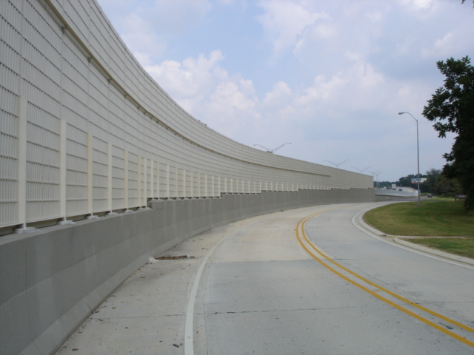

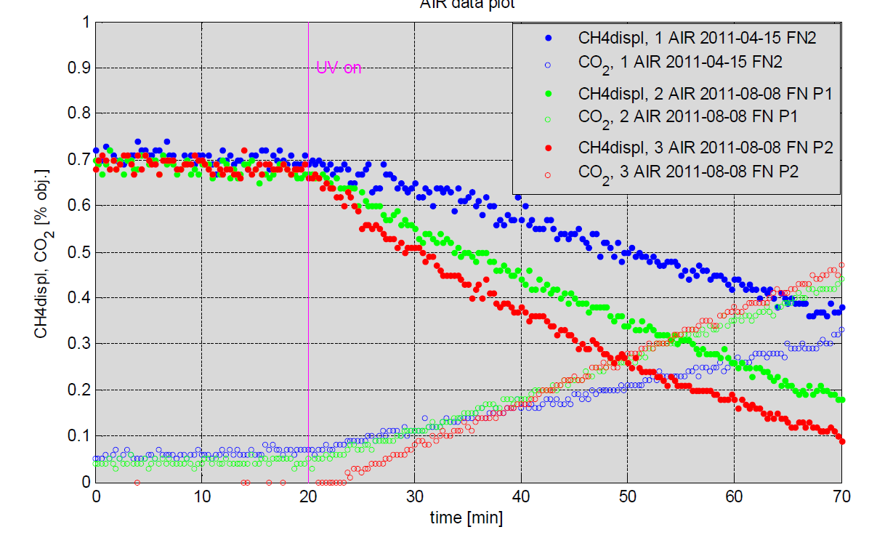
Hexane Concentration: 700ppm
Kinetics of photodegradation on FN®
6.5 mmol/h/m² ~ 546 mg/h/m²
High hexane concentration simulates spills of volatile organics or conditions in a closed environment with low circulation such as tunnels or highways with barriers on both sides.
FN3® = OPTIMIZED PRODUCT
100% OF THE TiO₂ PHOTOCATALYTIC ACTIVITY!!!

Slide 19

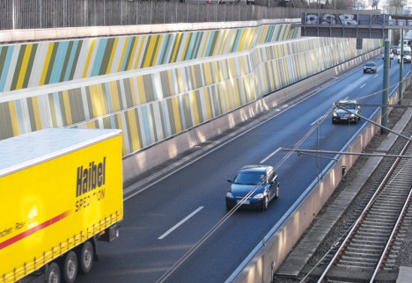

According to the test
(for instance in the case of ecological
catastrophe, or spill recovery),
1 km of sound barrier (5m high) painted with FN® is capable to remove photocatalytically 12,000 kg of organic pollutions of the air annually
Similarly, over 95% of the starting concentration of 770 ppm of n-butanol are mineralized in 15 minutes
REACHED THE THEORETICAL MAXIMUM
(100%) = PCA OF TiO2!!!
FN®- 3
Red line
100%

Slide 20
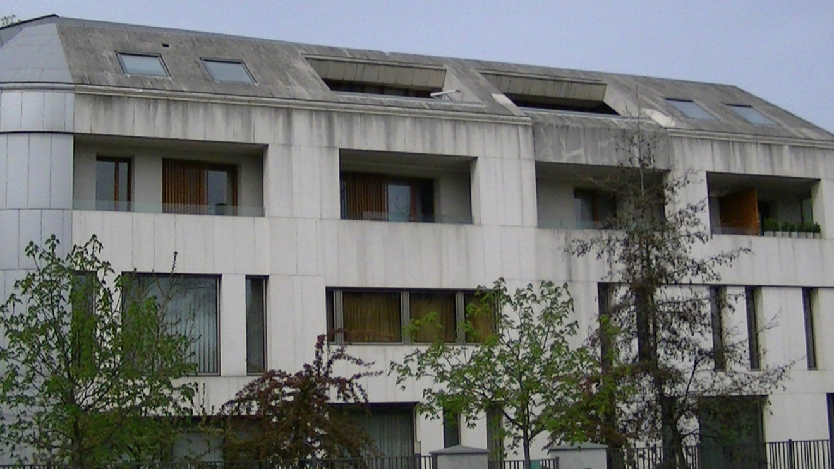
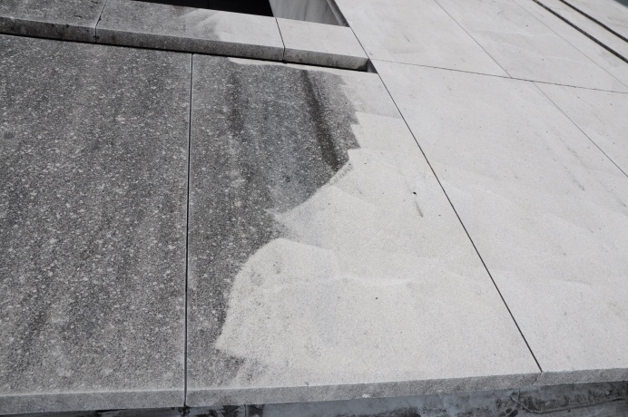
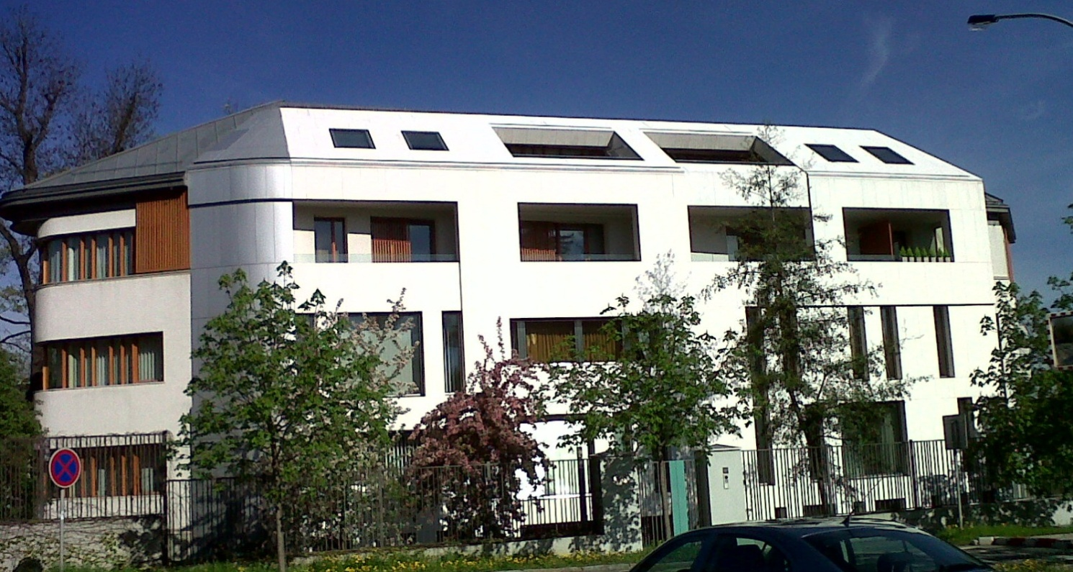
EXAMPLE
(Façade~350m²)
PRESSURE WATER
Marble building VILLA BIANCA
BUILT 2004
+FN®

Slide 21
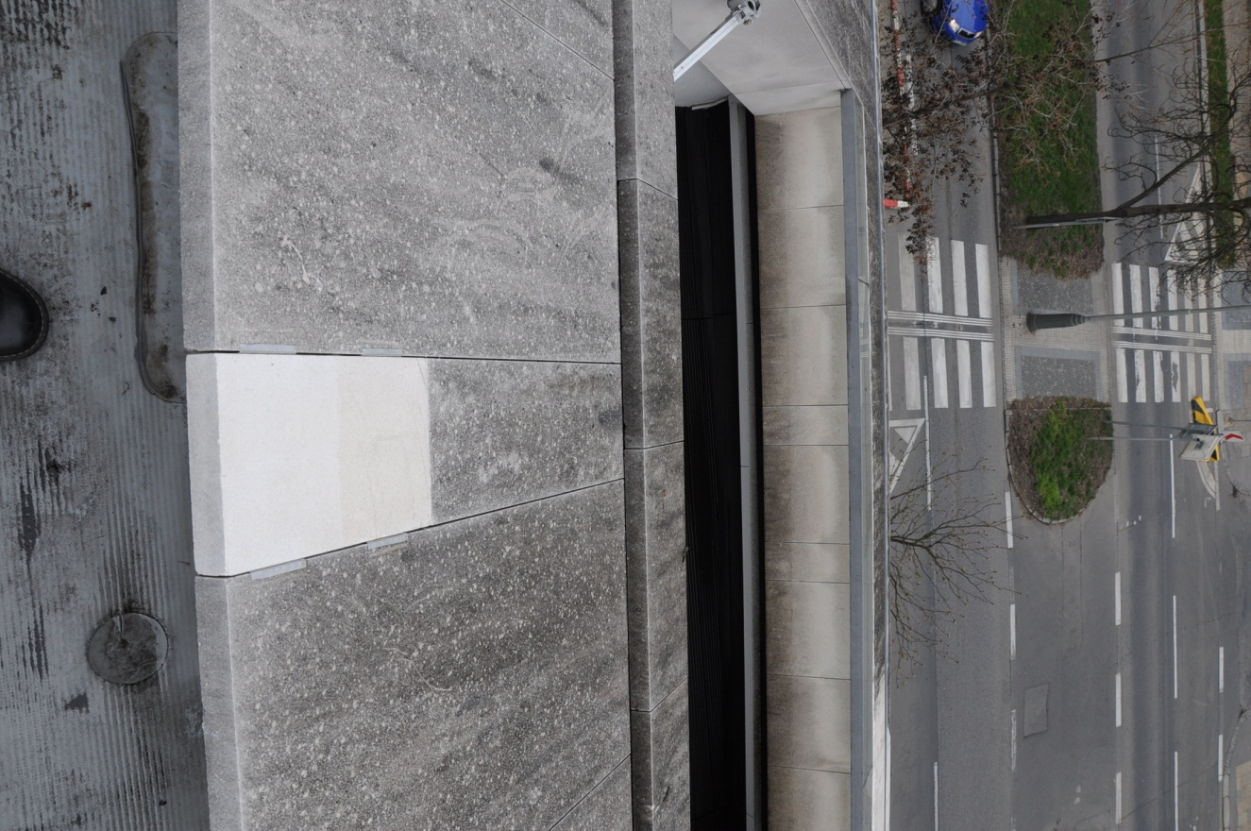
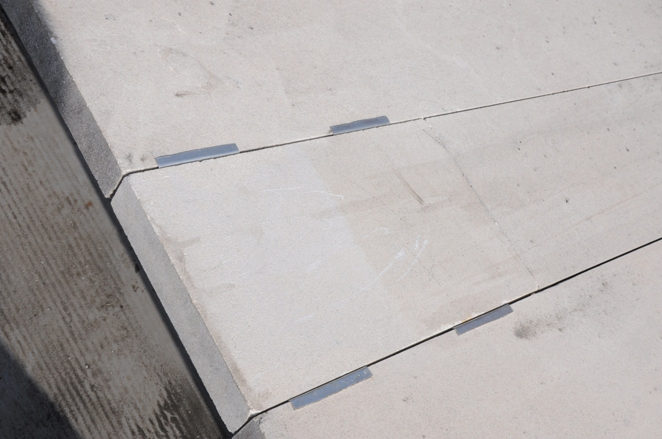
PRESSURE WATER 2
FN®
PRESSURE WATER 1;
APPARENT NEW DIRT DEPOSITS AFTER 1 YEAR
CLEAN SURFACE
FN®
VILLA BIANCA
EXPERIMENTAL TILE-EVALUATION AFTER 1 YEAR

Slide 22
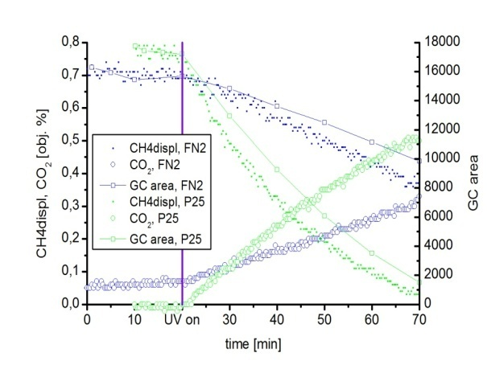

VOC removal capacity
VILLA BIANCA, COATED WITH FN® DECONTAMINATES OVER ONE BILLION OF CUBIC METERS OF AIR ANNUALLY!!!
NOx removal capacity
1,000,000,000 m³
SOLUTION TO THE EXHALATION PROBLEM!!!

Slide 23



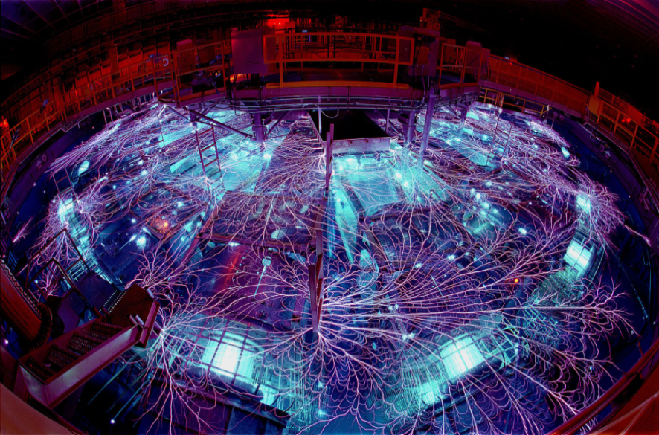
FN® COATED BUILDING
ECO MACHINE-AIR CLEANING TECHNOLOGY!
LOW TECH / LOW INVESTMENT COST/ ZERO-ENERGY- CONSUMPTION AIR DECONTAMINATION SYSTEM
HOW WOULD HAVE A MACHINE WITH
THE SAME AIR DECONTAMINATION CAPACITY LOOKED LIKE?
What would be the initial investment cost?
Energy consumption?
Life span?
Maintenance cost?
Space requirements?
Operation cost?
Liquidation expenses?
OTHER ????
Ø 6.5 m~ 33m²
Air velocity>1m/s

Slide 24



POLLUTIONS DISSOLVE IN RAIN CONTAMINATING WATER
FN® SURFACES PHOTOCATALYTICALLY CLEAN CONTAMINATED RAIN, QUICKLY REMOVING ORGANIC COMPOUNDS IN ORDER OF MINUTES/HOURS

Slide 25
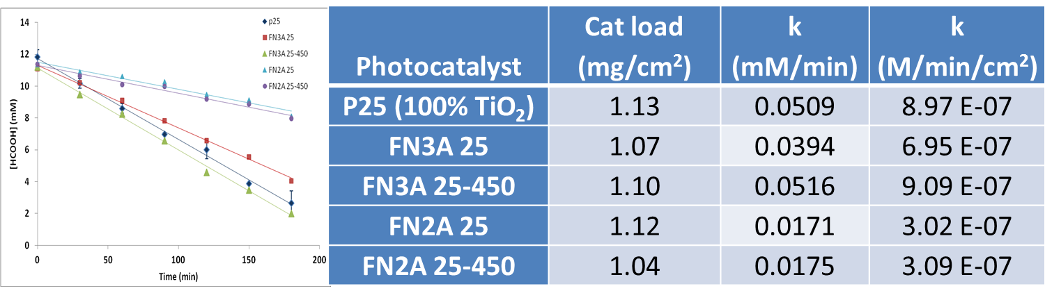
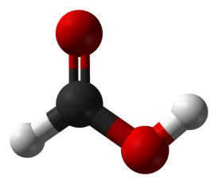
KINETICS-FUNDAMENTAL DATA
FORMIC ACID
4-chlorophenol
Starting concentration: 0.0008M/L
k_{FN2TiO2}=0.5/h
k_{FN3TiO2}=1.1/h

Slide 26
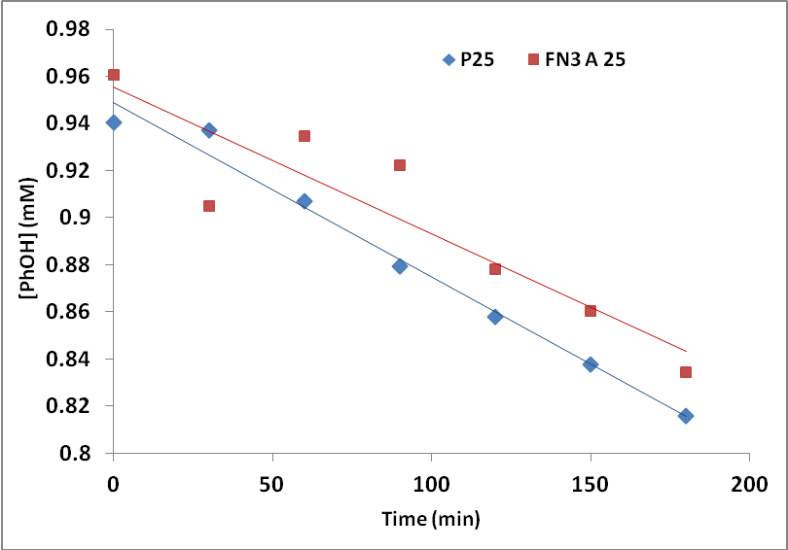
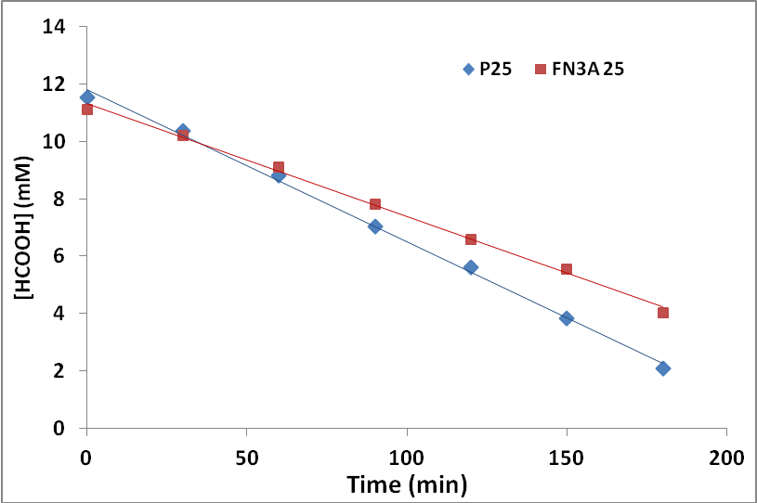
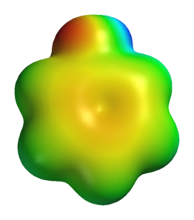

Photocatalyst | Pollutant | Catalyst loading (mg/cm²) | R_{i} (mol L⁻¹ min⁻¹ cm⁻²)
P25 (100% TiO2) | Phenol | 1.22 | 1.23 E-08
FN3A 25 | Phenol | 1.13 | 1.06 E-08
P25 | Formic acid | 1.13 | 9.36 E-07
FN3A 25 | Formic acid | 1.07 | 6.95 E-07

Slide 27
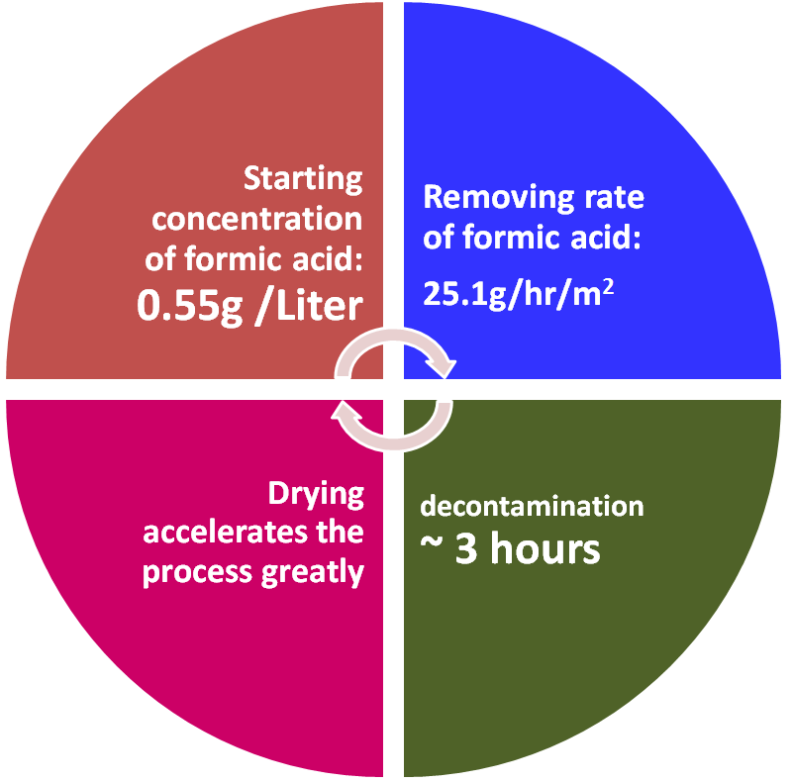

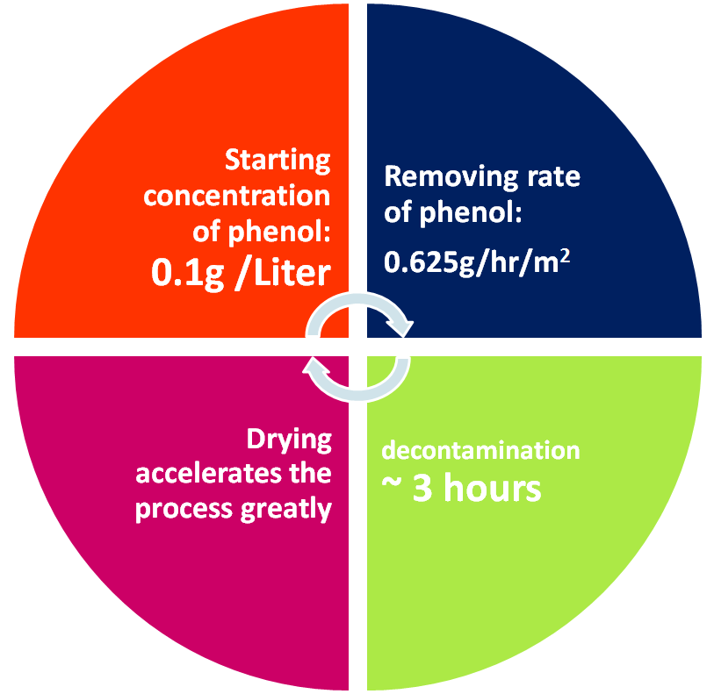



WHAT DO THE FUNDAMENTALS MEAN
IN REAL CONDITIONS?

Slide 28
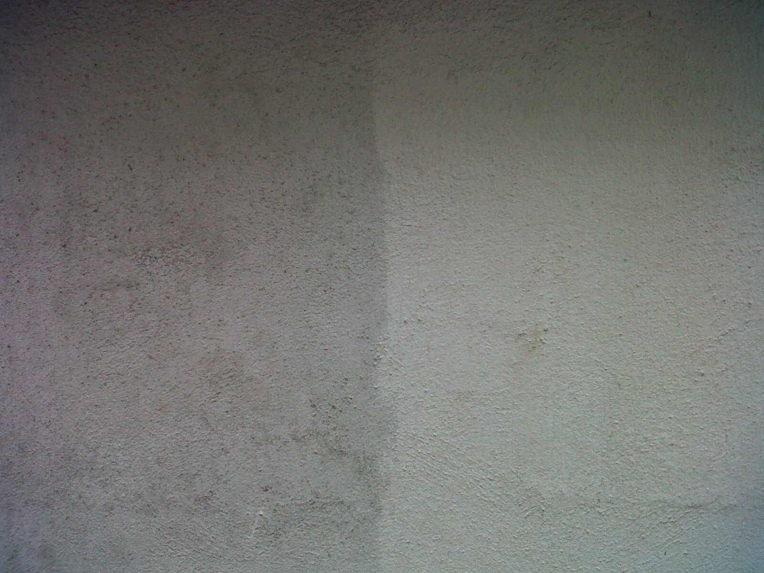
FN®
CREATE LONG TERM SELF-CLEANING SURFACES
CAN HANDLE EVEN MUD SPLASHES AT THE ROADSIDE
CLEAN CRACKS AND INTERSTICES!!!
PROTECT SURFACE AGAINST UV RADIATION
PREVENTS ALGAE, FUNGI, LITCHEN, MOSS AND OTHER ERODING MICROORGANISMS
FN®

Slide 29




CAN HANDLE EVEN MUD SPLASHES AT THE ROADSIDE
BOTH SIDES HEAVILY CONTAMINATED AFTER WINTER
FN® SIDE CLEAN
April
February
Regular façade paint
FN®2
Regular façade paint
FN®2

Slide 30
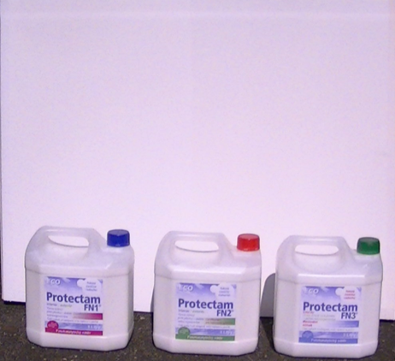
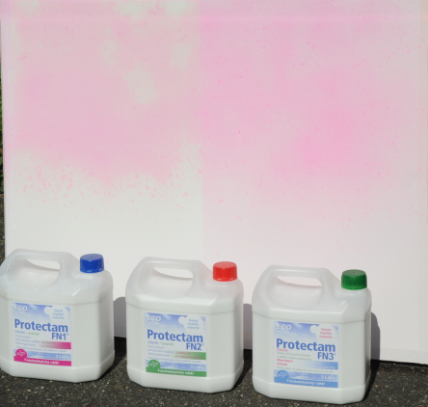
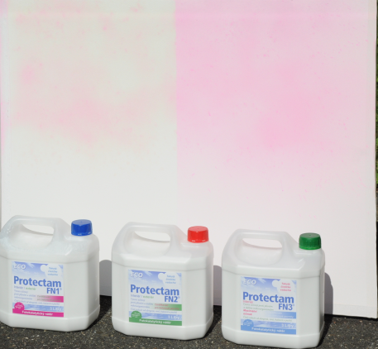
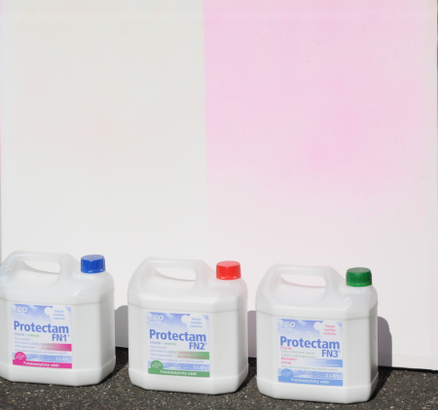
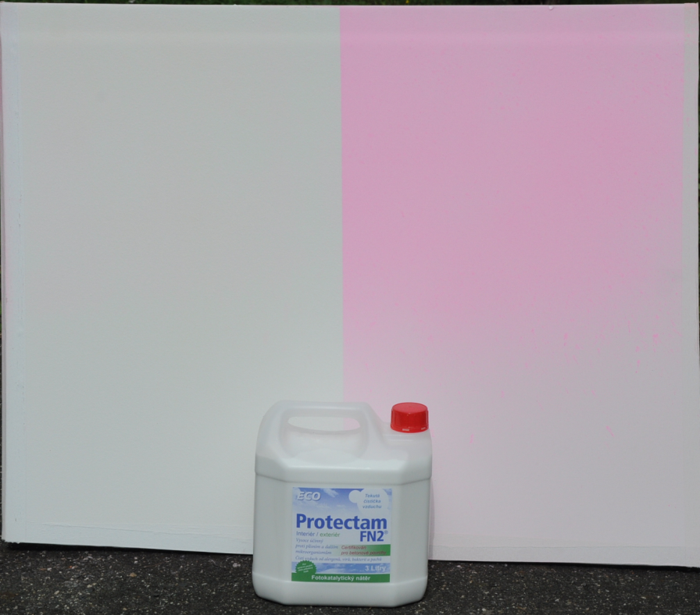
SELF-CLEANING POWER– VERY STRONG
CONTAMINATION RHODAMINE B
5-7 MINUTES TO COMPLETE DEGRADATION OF THE DYE
FN®
STRONG AND PERMANENT EFFECT:
CANNOT BE EXHAUSTED!!!
DECONTAMINATION OF FN® SURFACE FROM ORGANIC COMPOUNDS
REPEATED 3x IN 20 MINUTES

Slide 31



FN®-SIGNIFICANT STOPPING-EFFECT FOR GREEN ALGAE!!!
FN®
FN®

Slide 32

WORKS ON WOOD!!!

Slide 33




LONG-TERM PROTECTION AGAINST AGEING, DIRT AND MICROORGANISMS EVEN IN HIGHLY EXPOSED LOCATIONS
normal
FN ®

Slide 34


FN®
PREVENTS GROWTH OF GREEN ALGAE→LICHEN → MOSS AND OTHER EROSION FACTORS

Slide 35


FN® - SIGNIFICANTLY REDUCES OCCURRENCE OF SPIDER WEBS!!!

Slide 36






FN® Coating with spots of regular paint
FN® - HYDROPHILIC CHARACTER
Spray – HYDROPHOBIC SOLVENTS
REPELLING EFFECT
ASK FOR ANTIGRAFFITI VIDEO
ANTIGRAFFITI

Slide 37

OTHER ATTRIBUTES:
CERTIFIED FOR CONCRETE
HIGH WATER PERMEABILITY Sd[m]=0.06
HIGH ADHESION TO THE SURFACE 3.4MPa
DURABILITY IN DECADES (SEE MANUFACTURER’S DECLARATION AND WARRANTY)
CHEMICALLY RESISTANT (1542:2000; EN 13529:2004)
FREEZE RESISTANT 3.2MPa AFTER 25 FREEZING CYCLES (ISO 4628-1,2)
SALT WATER RESISTANT
NO VOC; FULLY MINERAL COMPOSITE
NO HEALTH RISK (ISO 16000-10, 16000-10/11 )
ENVIRONMENTALY SOUND AND SAFE
MECHANICALLY REMOVABLE WITHOUT DAMAGE TO THE SURFACE
FUNCTIONAL EVEN AT THICKNESS UNDER ONE MICRON
PHYSICAL EFFECT – NO CHEMICALS INVOLVED
LONG SHELF LIFE (3-5 YEARS)

Slide 38

FN® sets a new standard for:

Slide 39



























EXAMPLES
GIC

Slide 40

PREPARED FOR NANO COMMODITY MARKETS
EMERGING MARKET WITH OVER 2,000,000 sq ft INSTALLED IN THE PAST 2 YEARS
EMISSION CONTROL
BUILDINGS PROTECTION
MILITARY PROTECTION
INDUSTRIAL USE
AGRICULTURE
TRANSPORTATION
AMJTJ’S TiO₂ MANUFACTURING PROCESS - STRATEGIC COMPETITIVE ADVANTAGE ALLOWING SIGNIFICANTLY MORE ECONOMICAL PRODUCTION OF FN® COATINGS IN THE FUTURE

Slide 41



Czech Republic
Slovak Republic
Spain
Portugal
Africa
Australia
New Zealand
Vietnam
Poland
Canada
USA
Ireland
Sweden
China
United Arab Emirates
The World is Ready....
Why Wait!
FN® Global Network
Thank you for working with us Today on cleaner Tomorrow

