Slide 1
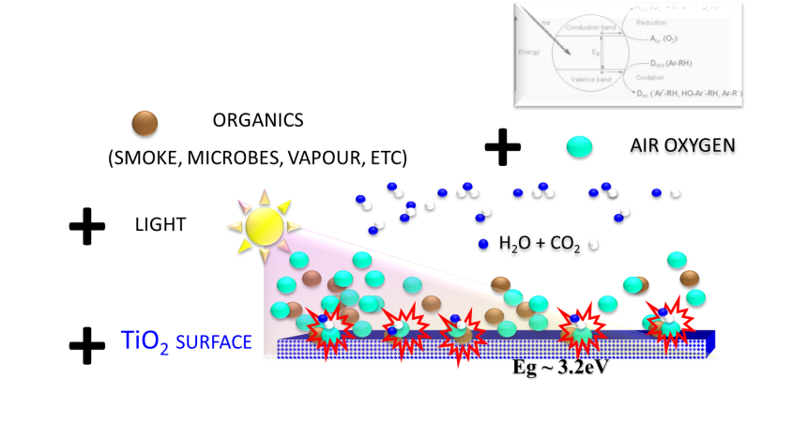

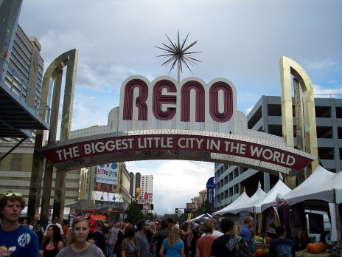
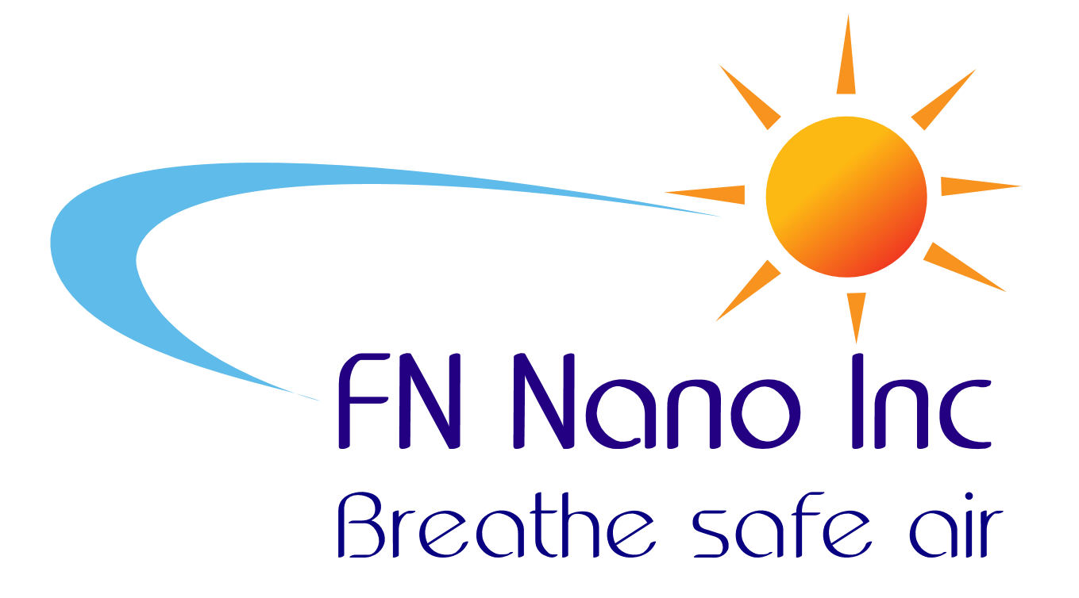
Photocatalysis for daily life
FN® COATINGS - changing the hotel industry
SMOKING AND HYPO-ALLERGENIC ROOMS

Slide 2
CLEAN ROOMS - NEW TREND IN THE HOTEL INDUSTRY
                Market entry: 2005
                Market initiative: 2010
                Established market – 2013?
Hotels have a major issue with smoke, air quality and central air system
FN® COATINGS – EXCELLENT SOLUTION TO THE PROBLEM

Slide 3
By coating the hotel rooms with FN® we can offer effective solution to allergies, bad odors, mold, etc.,
FN® Coatings turn regular hotel rooms into
Hypo-Allergenic Rooms, suitable for people with heavy allergies.
FN® are further useful for:
Remove toxins from mites, bacteria
Prevent musty deposits and bad odors
Keep HVAC cleaner
($ savings)
FN®
Pet rooms
Smoking rooms
HVAC

Slide 4
HYPO-ALLERGENIC ROOMS
The rooms, already offered at more than 70 of the chain's hotels, cost an extra $20 to $30 a night.
The initiative in hypo-allergenic rooms has started around 2005
Hyatt Hotels launched Respire by Hyatt, an initiative that calls for 2,000 hypo-allergenic rooms at 125 of its properties nationwide by year's end.
Hyatt announced this differentiation in 2010
http://health.usnews.com/health-news/family-health/allergy-and-asthma/articles/2010/11/23/how-to-have-an-allergy-free-hotel-stay

Slide 5
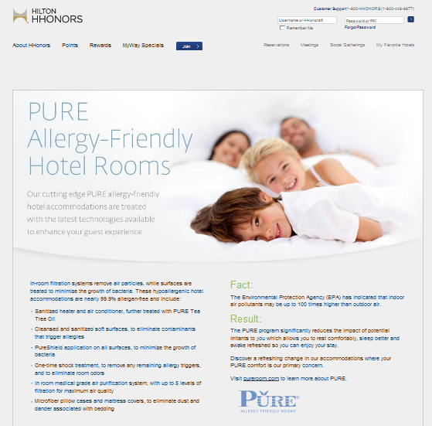
OTHER HOTELS HAVE FOLLOWED THE HYATT’S INITIATIVE
NYLO Hotels, a new brand scheduled to open its first hotel in Plano, Tex., in November, plans to offer at least one floor of allergy-friendly rooms at each of its locations.
N.Y. Thayer is converting about 10 percent of the rooms at each of its 13 hotels into Pure rooms by the end of this year.
“I go to hotels all the time, and I’m allergic to everything in the whole room,”…….“It’s a total nightmare,” he said. “Every hotel I go to, be it the Ritz-Carlton or the Motel 6, same problem.”

Slide 6
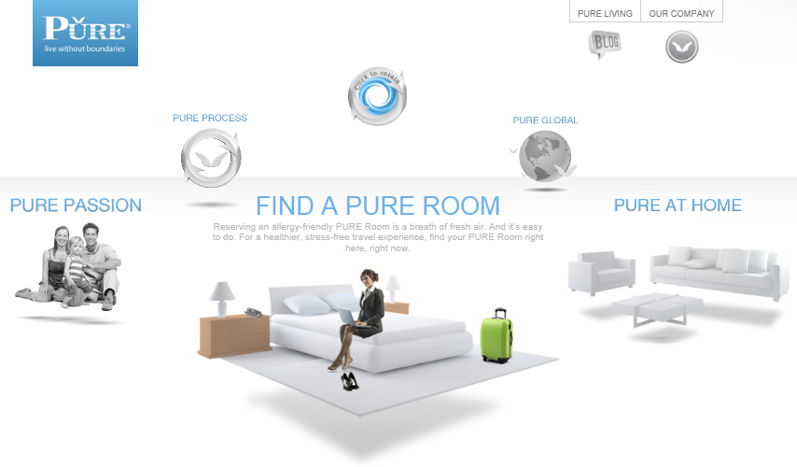
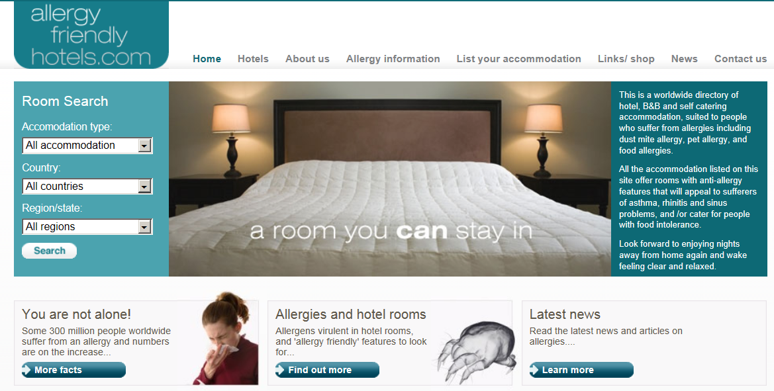
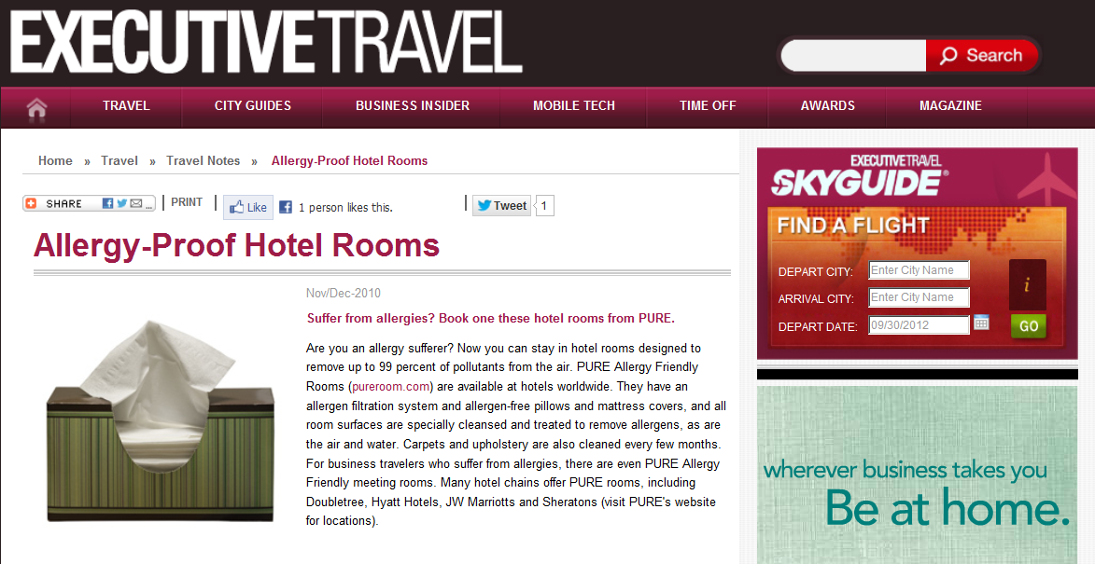
MARKETING ORGANIZATIONS ADOPTED THE STYLE
As more hotels try to set themselves apart, a new amenity is emerging: the hypoallergenic hotel room.

Slide 7

The concept isn’t aimed just at the allergic, but also at guests who are concerned with what might be called the ick factor. “The whole thing is geared toward ‘What about the guy before me?’
Mostly, hotels see the creation of super-clean rooms as a way to gain an edge now that amenities like plush beds and flat-screen TVs have often become standard.

Slide 8
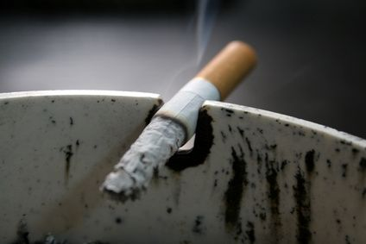
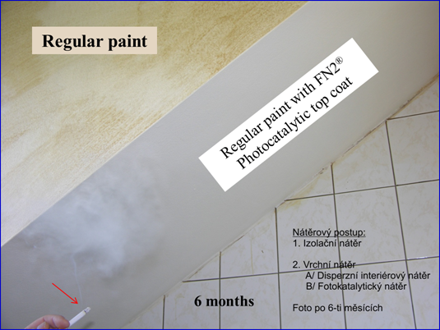
SMOKING
ROOMS
FN® COATING:
FAST SMOKE REMOVAL
ODOR ELIMINATION
NO MUSTY DEPOSITS
NOT A LONG TIME AGO
Non-smoking hotel rooms may be the standard now, but that hasn't always been the case. Even though the number of smokers in the United States has not significantly decreased since the 1980s, the number of public places that allow smoking has rapidly decreased. Many states--including North Carolina and Virginia--have indoor smoking bans that make it illegal to smoke inside restaurants and public buildings. Smoking was banned on all airline flights in the United States in 1998. Hotels have followed suit. Leading the non-smoking hotel trend have been some major hotel players, including all Starwood, Disney and Marriot.
6 MONTHS

Slide 9




HYATT PROCEDURE :
FN® COATINGS:
REPLACES ALL THESE STEPS
SIMPLE WAY OF TURNING ANY HOTEL ROOM INTO A HYPO-ALLERGENIC ROOM
The Respire by Hyatt – Hypo-Allergenic Rooms purification process includes:
Application of PURE Shield and PURE Clean to minimize presence of allergens on carpet, upholstery and other surfaces in the room.
One-time shock treatment to minimize irritants.
Complete disinfection of Air Handling Unit and Installation of removable tea tree oil cartridge to maintain these conditions.
Installation of a powerful air purifier by Healthway, listed as a Class II Medical device by the F.D.A.
Installation of hypo-allergenic mattress & pillow encasings.
Recertification every six months.
+
UV-A LIGHT

Slide 10

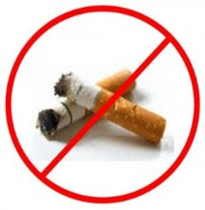
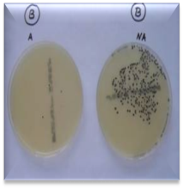

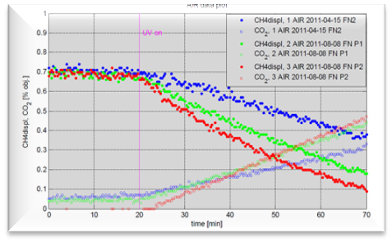
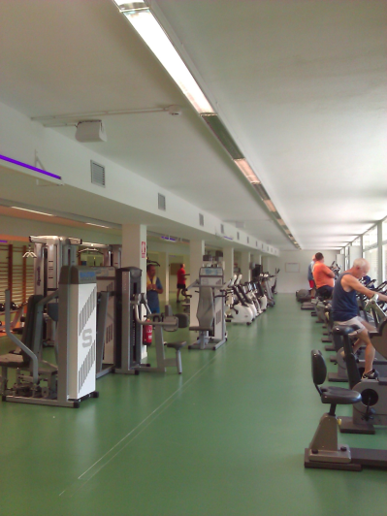
CHARACTERISTICS AND BENEFITS OF FN® PHOTOACTIVE SURFACES
SICK BUILDING SYNDROME SOLUTION
Removes bad odors
Burn smoke
Eliminate allergens
Prevent musty deposits
Stop mold
Kill viruses and bacteria
Protect health
Lower risk of infection
LOW-TECH AND EASY INSTALLATION (PAINTING ON THE WALLS)
ECONOMICAL AND PERMANENT SOLUTION TO IMPROVE HOTEL ENVIRONMENT
GREAT FOR ROOMS AND FITNESS CENTERS

Slide 11
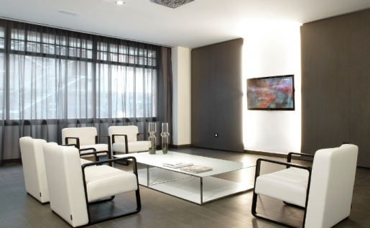
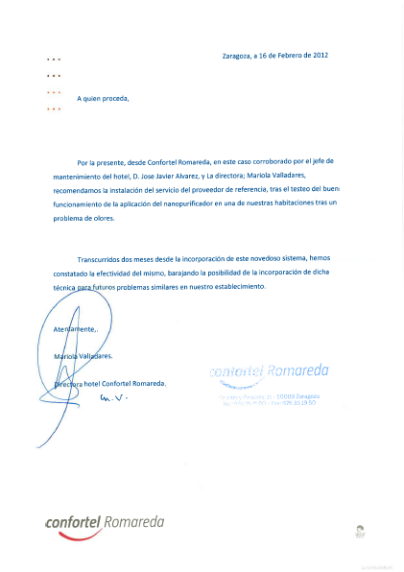
CONFORTEL REFERENCE
To whom It may concern,
By this letter, from the CONFORTEL ROMAREDA, issued by the chief of maintenance of the hotel, Mr. José Javiér Alvarez and the director Mariola Valladares, we recommend the installation and services of the referenced provider. FN Coatings (nanopurificador) was applied and its behavior and function tested in one of our rooms with smells and bad odor problems.
After two month from incorporation of this new air cleaning system, we can confirm the effectiveness of the same, considering the possibility to incorporate this technique to treat similar problems in our establishments in the future
Sincerely,
Mariola Valladares
Director of the hotel Confortel Romareda

Slide 12
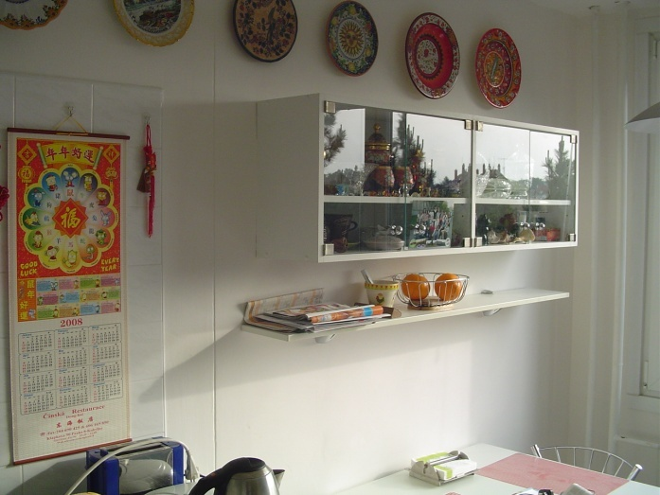
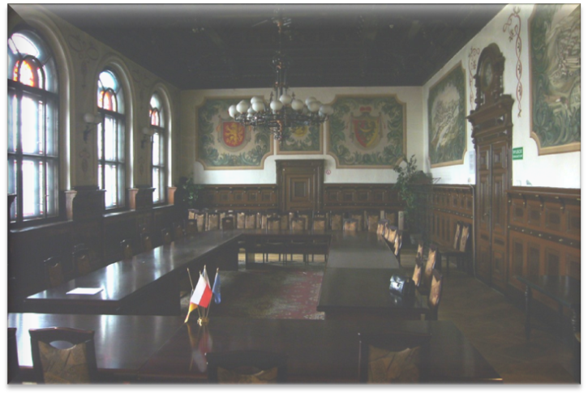
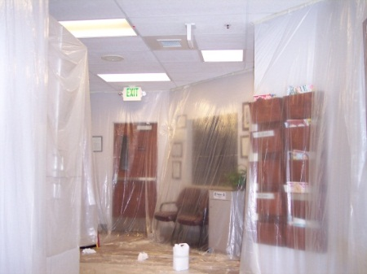
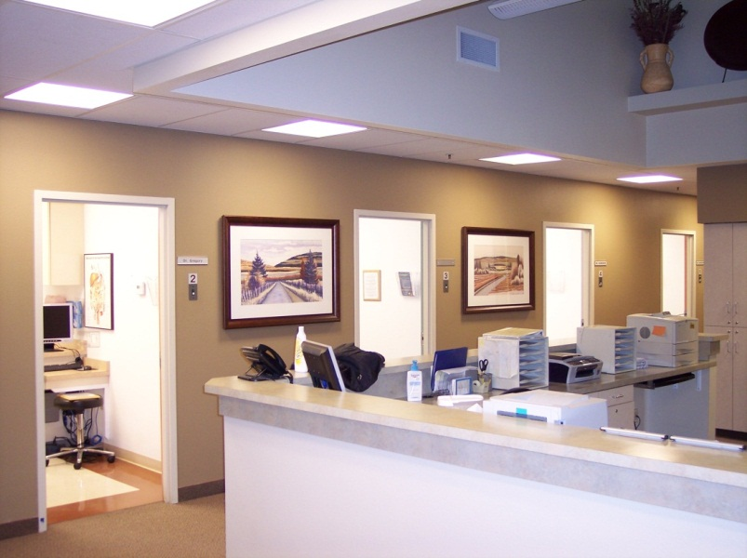
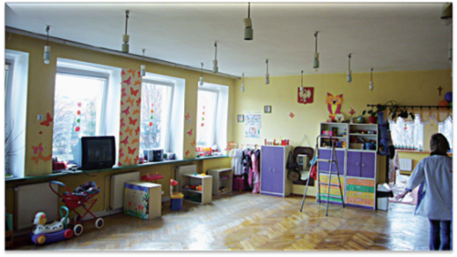
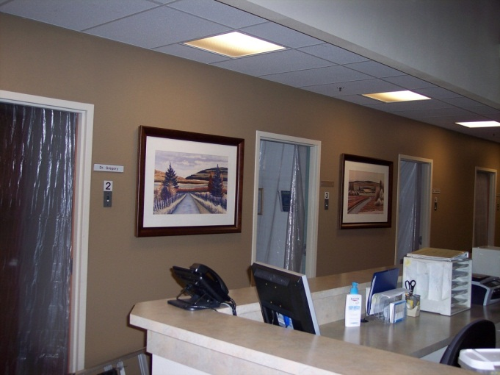
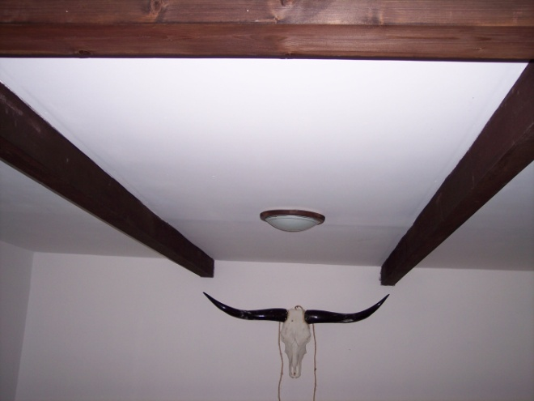
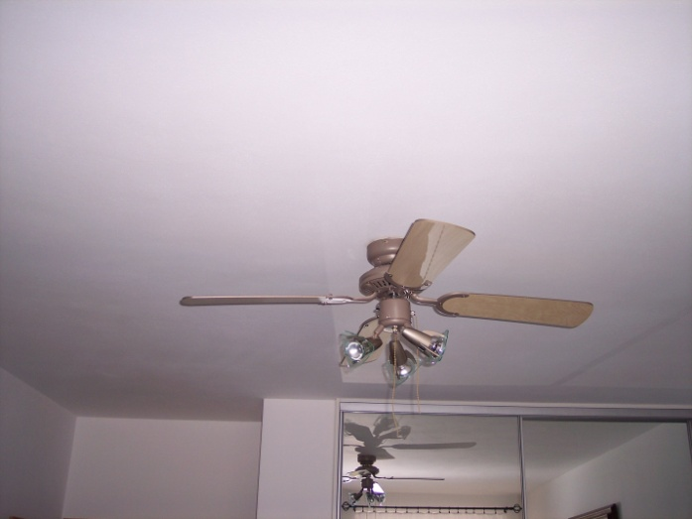
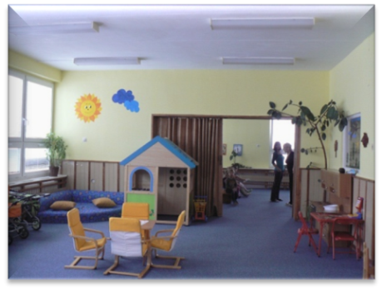
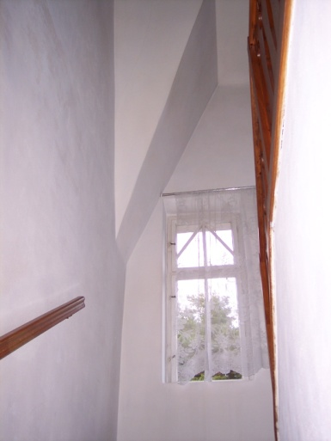
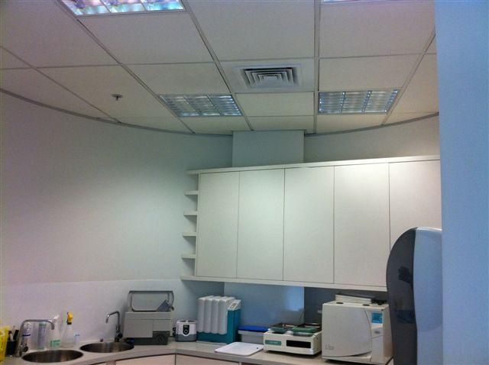
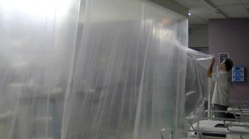
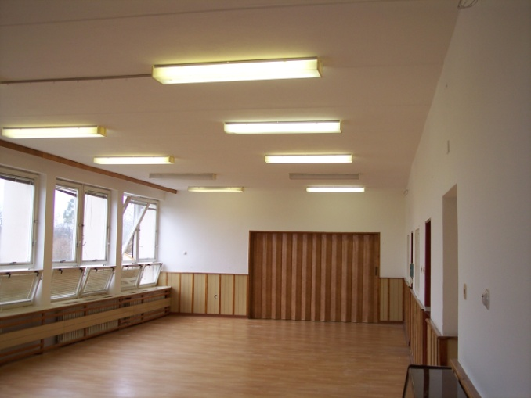
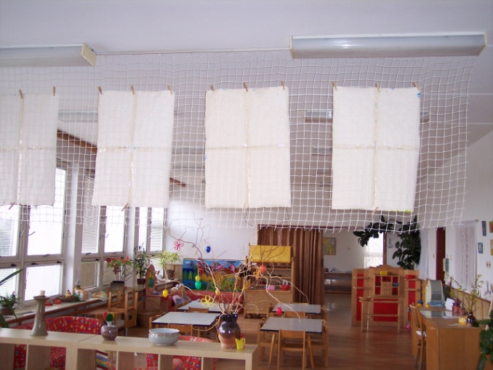
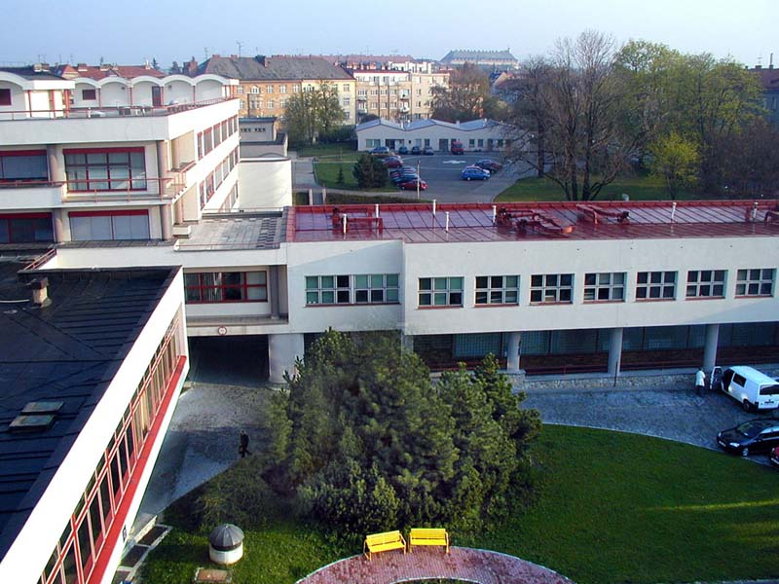
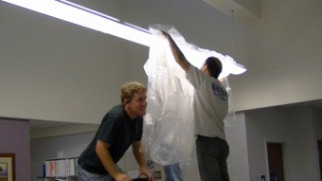
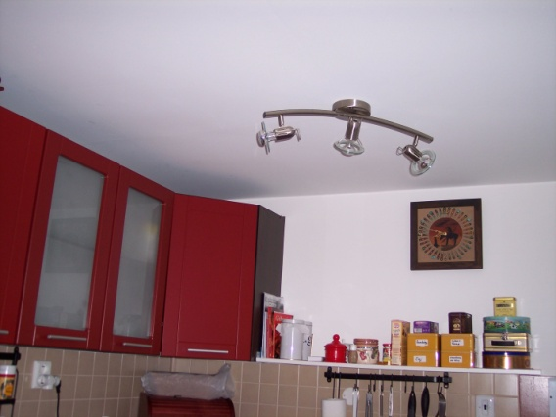
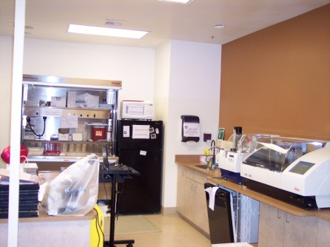
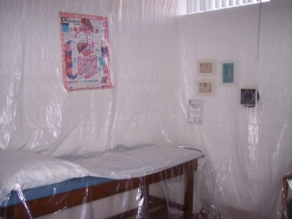

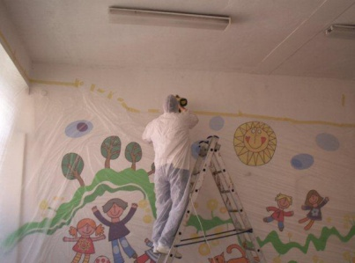

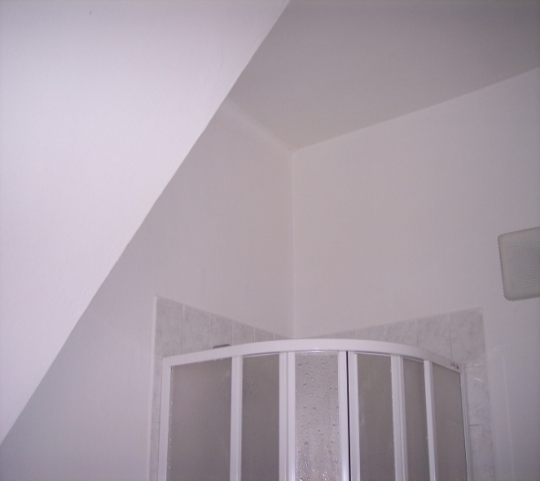
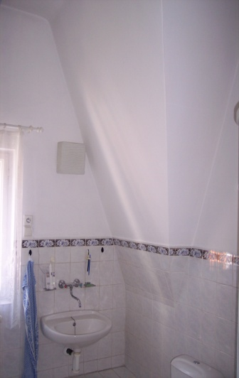
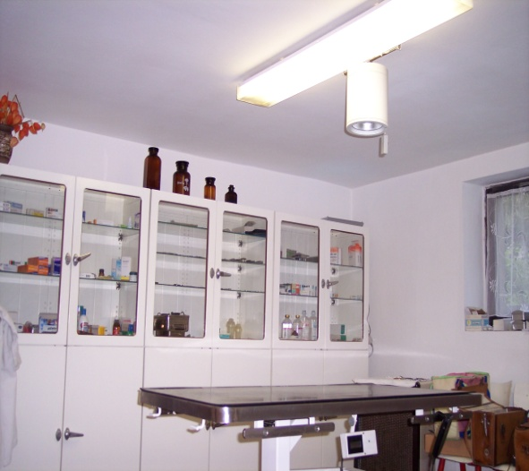
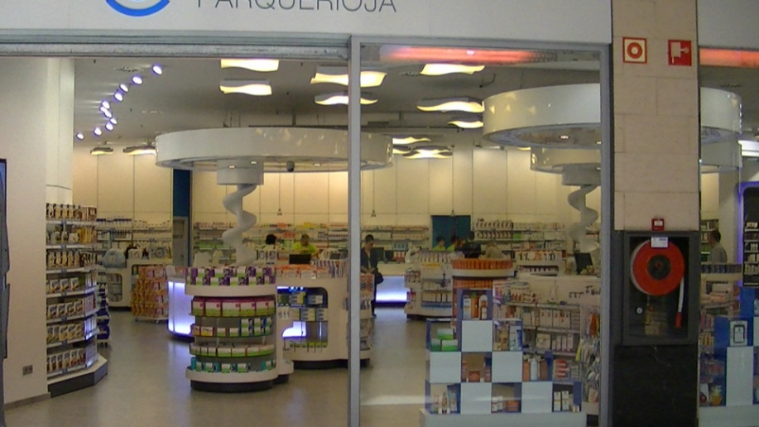

EXAMPLES
GIC

Slide 13
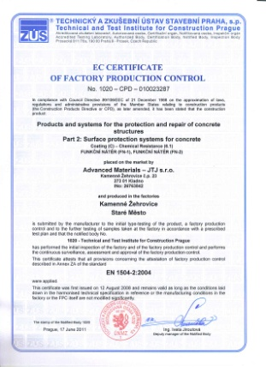
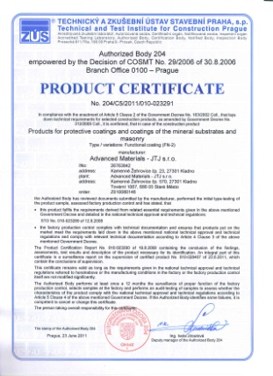
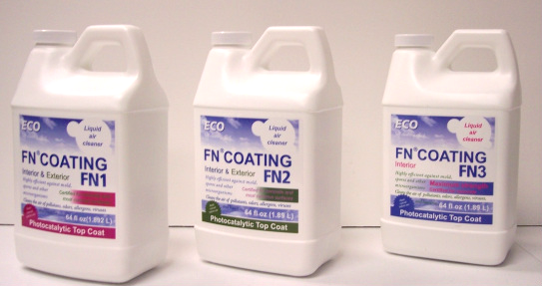


Your walls and ceiling can be the MOST EFFECTIVE cleaning system
http://www.fnnanoinc.com
BREATHE SAFE AIR
http://fnnano.com/?page_id=75
Basic info:
http://www.allergyfriendlyhotels.com/allergy-information/allergies-and-hotel-rooms
http://travel.nytimes.com/2007/03/25/travel/25pracallergy.html?pagewanted=all&_moc.semityn.levart
http://hhonors1.hilton.com/en_US/hh/landing/hww_pure/index.do
http://www.pureroom.com/
http://health.usnews.com/health-news/family-health/allergy-and-asthma/articles/2010/11/23/how-to-have-an-allergy-free-hotel-stay
http://answers.yahoo.com/question/index?qid=20080123112706AA1LzK2
http://articles.chicagotribune.com/2011-04-11/health/sc-health-0408-aa-hypoallergenic-20110411_1_hypoallergenic-rooms-pure-shield-allergy-sufferers
http://www.ehow.com/how_2365025_find-allergy-free-hotel-room.html
http://www.executivetravelmagazine.com/articles/allergy-proof-hotel-rooms

